Slide 1
Classical Substitution Ciphers

Slide 2
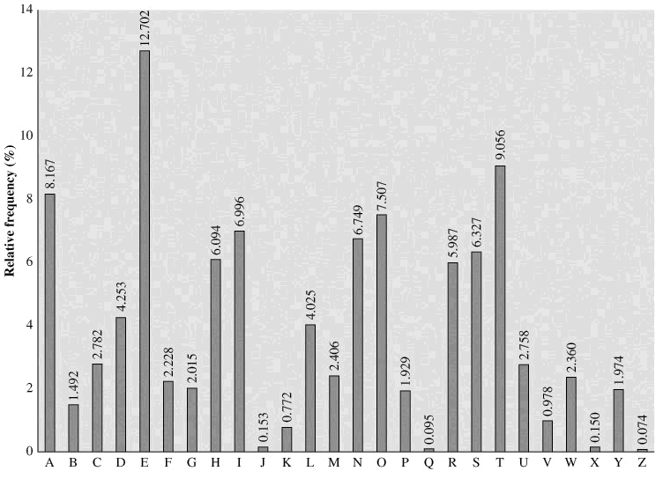
Cryptanalysis of substitution ciphers using histogram of ciphertext
Every language has a “usual” frequency distribution of
using letters
in the alphabet,
e.g. for English
letters, the
distribution is
as shown.

Slide 3
How can the attacker use the ciphertext letter frequency to break the cipher?
He can compare the letter frequencies in the histogram of ciphertext to the usual frequency in the plaintext histogram. The letter with the highest frequency should be the encryption of the letter “e”, and the letter with the second highest corresponds to “t”, and so on.
The net result will be that the letters with obviously high frequency are discovered without trials. If not all letters are found by comparing the histograms, then he can use brute force trials for fewer letters than 26. Thus the 26!
number of trials required for brute force is drastically reduced.

Slide 4
Polyalphabetic Ciphers
The basic idea is to encrypt every letter in different ways, for example “e” could be encrypted sometimes as “b”, sometimes as “m” and sometimes as “w”. Thus the frequency of “e” is split among three letters, and there is no way of making one-to-one comparison between histograms of the plaintext and ciphertext.
Using Vigenere tableau is one for doing such “polyalphabetic” substitution using different substitution keys, yet the communicating parties need to exchange only a short “keyword”.

Slide 5
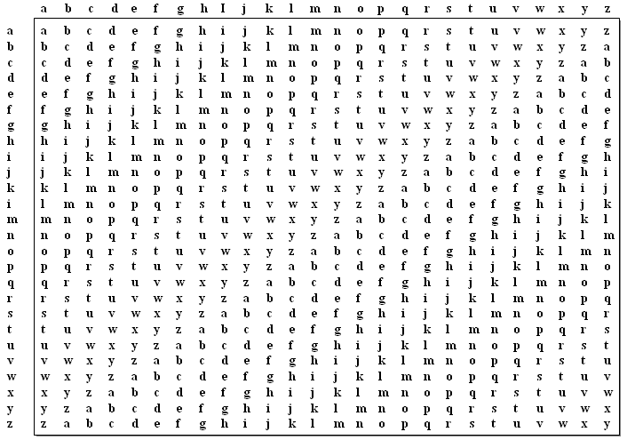
Vigenere Tableau
Every column represents a different encryption key

Slide 6
Example : encryption of plaintext “security” using keyword “sec”
k3
k2
k1
Letters of the plaintext “security”

